Slide 1
ChoiMear Museum
Younghoon and Will

Slide 2
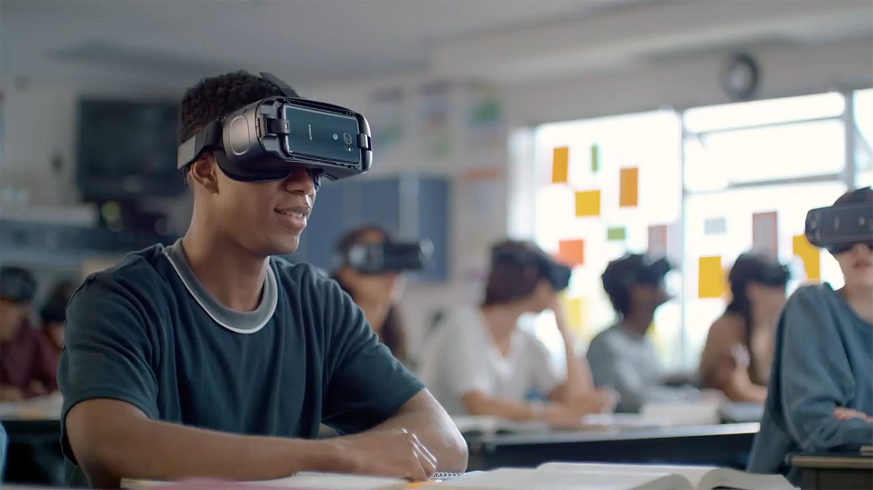
Goal of this Research
Testing the effectiveness of learning through VR vs reading on a computer.

Slide 3
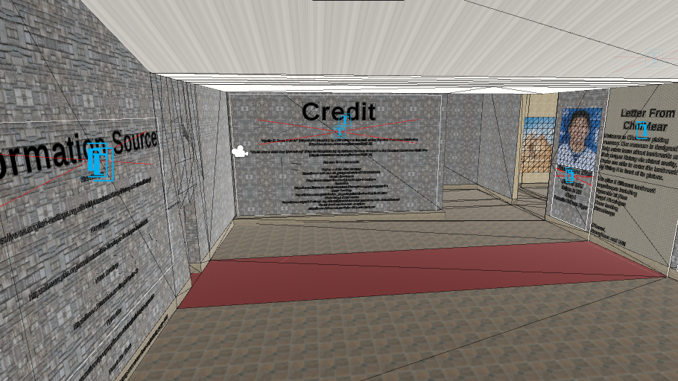
Museum
Pro Builder || Canvas UI || Textmesh Pro || Asset store for location representation
User is able to move with joy sticks

Slide 4
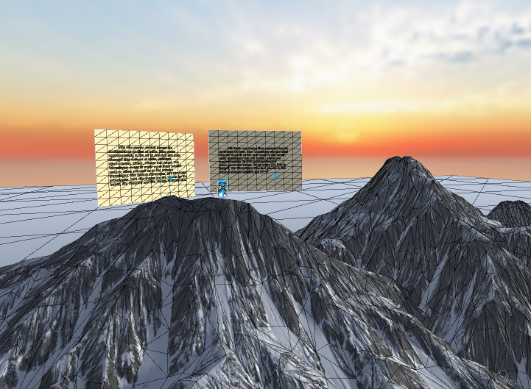
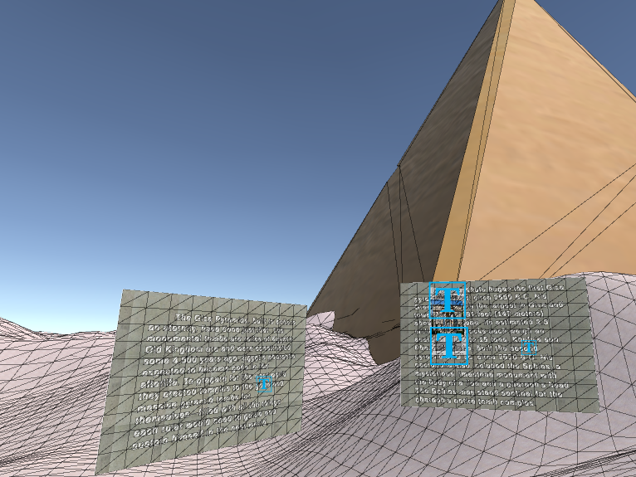
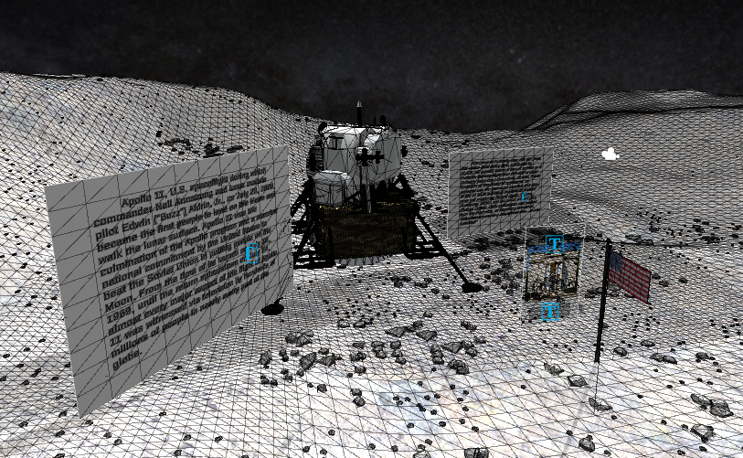
Scenes #1

Slide 5
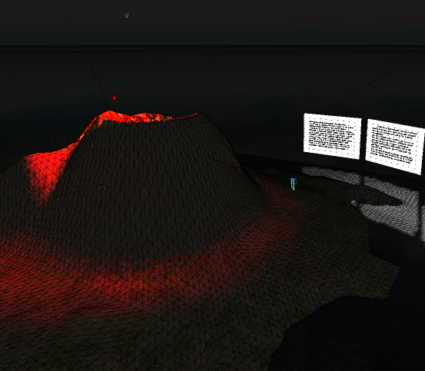
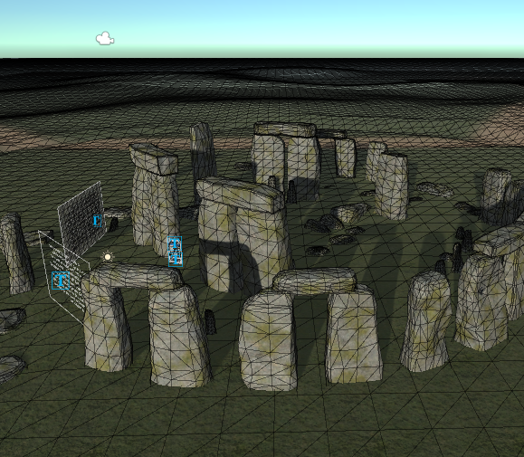
Scenes #2

Slide 6
Sample data
20 people in total
13 males 7 females
Test was done anonymously

Slide 7
Data
10 people were given an article
10 people were given VR
4 tried each of 5 different learning topics

Slide 8
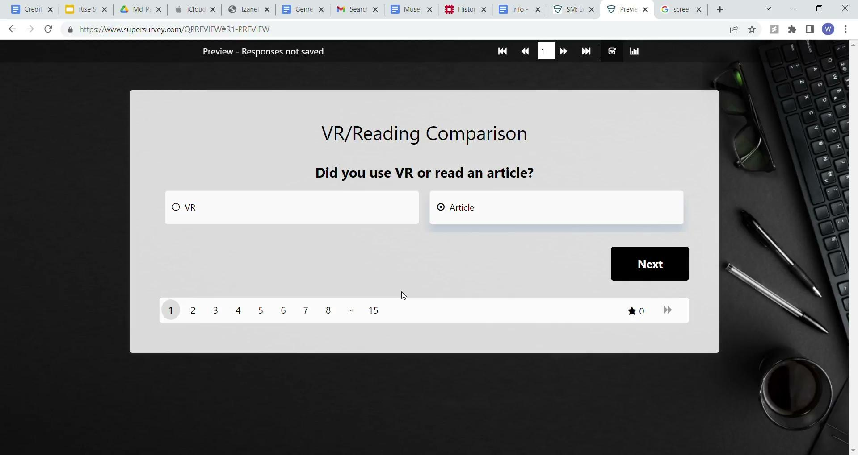
Survey
Participants were asked to rank their experience

Slide 9
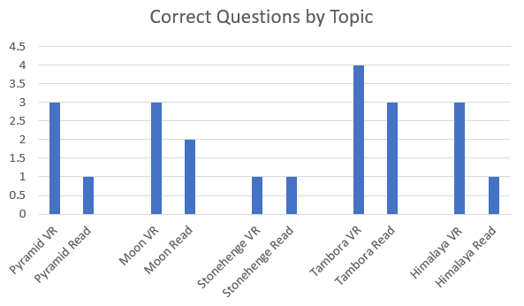
Results
Reading had an average interest of 2.4
VR had an average interest of 4.0

Slide 10
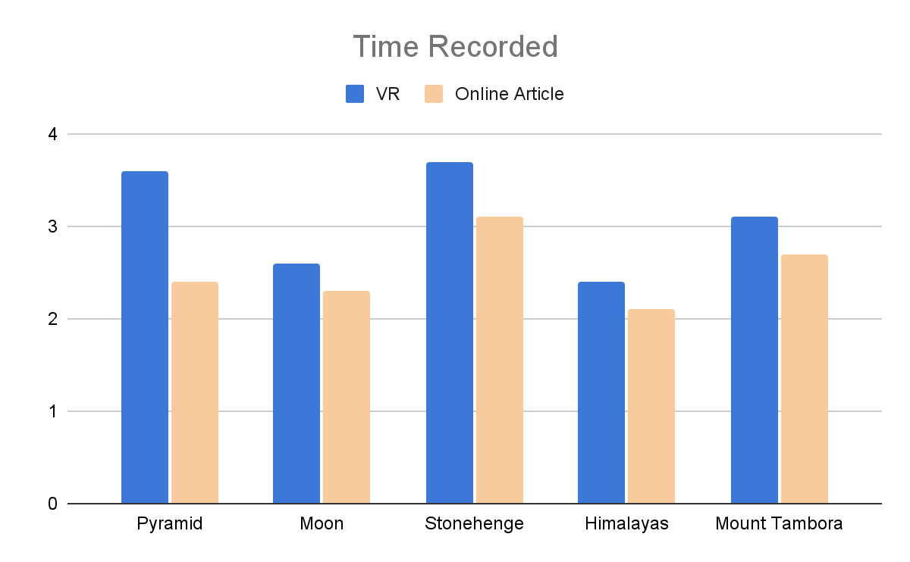
Time Taken
- Learning through virtual reality took 28.8 seconds longer than reading an article in average.
-Pyramids had the biggest gap difference with 48 seconds
-Same information given to both condition

Slide 11
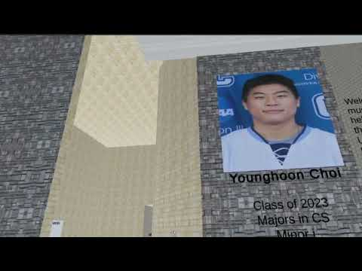
Video

Slide 12
Sources
Stonehenge:
https://www.english-heritage.org.uk/visit/places/stonehenge/history-and-stories/history/
Himalayas:
https://www.pbs.org/wnet/nature/the-himalayas-himalayas-facts/6341/
Moon Landing:
https://www.britannica.com/topic/Apollo-11
Pyramids:
https://www.nationalgeographic.com/history/article/giza-pyramids
Mount Tambora:
https://www.nesdis.noaa.gov/news/day-history-mount-tambora-explosively-erupts-1815

Slide 13
3D Credit
Asylums of the 20th century:
https://www.ncbi.nlm.nih.gov/pmc/articles/PMC6188234/
Nepal Himalayas:
https://www.britannica.com/place/Nepal-Himalayas
Pyramids:
https://www.history.com/topics/ancient-history/the-egyptian-pyramids
Moon Landing:
https://www.nasa.gov/mission_pages/apollo/missions/apollo11.html
Stonehenge Monuments:
https://www.english-heritage.org.uk/visit/places/stonehenge/history-and-stories/history/
Mount Tambora Volcano Eruption:
https://www.britannica.com/place/Mount-Tambora

Slide 14
Thanks!

